Slide 1
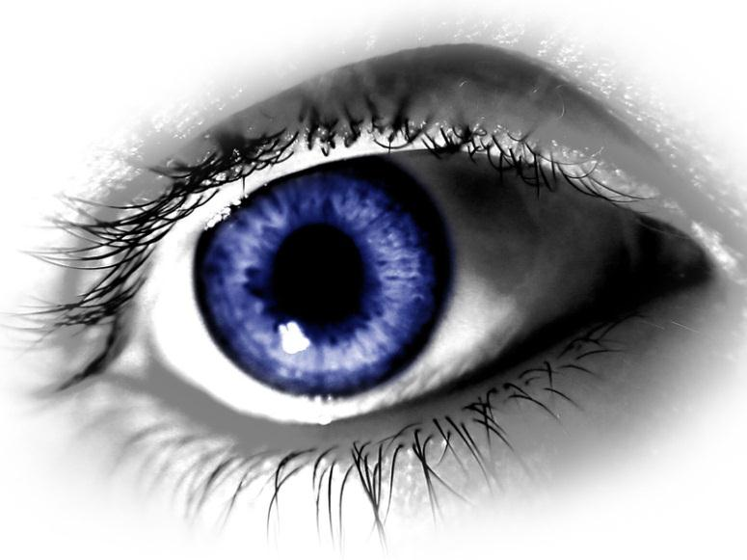
Point of View and Perspective
Understanding the Characters in a Story
Take notes as you go through each slide

Slide 2
Consider This…
“You never really understand a person until you consider things from his point of view…until you climb into his skin and walk around in it.”
-Harper Lee from To Kill a Mockingbird

Slide 3
What is Point of View?
Point of View is the way an author crafts his or her story to allow the reader to see and hear what is happening
The points of view that are most commonly found in literature are:
First Person Point of View
Third Person Point of View

Slide 4
First Person Point of View
You can identify first person point of view by looking for the following pronouns:
I
Me, My
We, Us
The narrator is a character in the story.
The reader only knows what the NARRATOR reveals about their thoughts, feelings, and actions.

Slide 5
Third Person Point of View
You can identify third person point of view by looking for the following pronouns:
He
She
They, Their, Them
The narrator is NOT a character in the story.
The reader only knows what the author wants to reveal.
We can know the thoughts, feelings, and actions of ONE character or ALL characters.

Slide 6
What is Perspective?
Perspective is the lens through which the story is told.
Think about it like this:
If you were wearing a pair of glasses, which character’s glasses are you wearing? Through whose lenses do you see the world?
When we understand a character’s perspective, we get to walk in the shoes of that character.

Slide 7
Point of View & Perspective
It is easy to get these terms confused!
Point of View is the way an author allows the reader to see and hear what is happening.
Is the narrator a character in the story? (first person)
Is the narrator an outsider? (third person)
Perspective is the lens through which the story is told.

Slide 8
So What’s the Difference?
The point of view from which the story is told determines whose perspective the reader gets to experience.
For example, in first person point of view, you only get to understand one character’s (the narrator) perspective.
In third person point of view, the narrator is an outsider, so the reader may see one, some, or all of the characters’ perspectives.

Slide 9
How Does an Author Reveal Perspective?
An author uses the following strategies to reveal the perspective of a character:
Thoughts
Feelings
Actions
Dialogue
What other characters say and think about the character
What other examples can you think of?

Slide 10
Vocabulary Study
Complete a vocabulary study for the key terms:
Point-of-view
Perspective
Create this in your Office 365. Title the assignment Vocabulary Study – Unit 1. This will be number one. You will continue to add more terms to this sheet as the unit goes on.

